Slide 1

SUPPORT VECTOR MACHINE

Slide 2
Support Vector Machine(SVM)
Support Vector Machine(SVM) is a supervised machine learning algorithm used for both classification and regression.
The objective of SVM algorithm is to find a hyperplane in an N-dimensional space that distinctly classifies the data points.
The dimension of the hyperplane depends upon the number of features.
If the number of input features is two, then the hyperplane is just a line. If the number of input features is three, then the hyperplane becomes a 2-D plane.
It becomes difficult to imagine when the number of features exceeds three.

Slide 3
SVM
In SVM, we plot each data item in the dataset in an N-dimensional space, where N is the number of features/attributes in the data.
Next, find the optimal hyperplane to separate the data. By default, SVM can only perform binary classification (i.e., choose between two classes).
However, there are various techniques to use for multi-class problems.

Slide 4
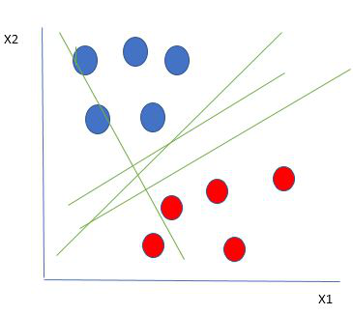
Example
Let’s consider two independent variables x1, x2 and one dependent variable which is either a blue circle or a red circle.
So how do we choose the best line or
in general the best hyperplane that
segregates our data points.
Linearly Separable Data points

Slide 5
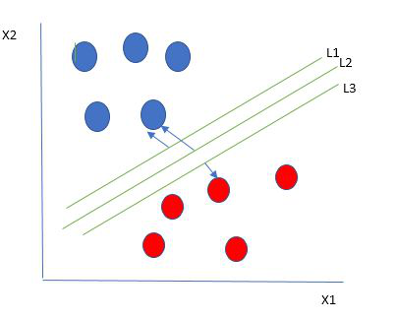
Selecting the best hyper-plane:
One reasonable choice as the best hyperplane is the one that represents the largest separation or margin between the two classes.
We choose the hyperplane whose distance from it to the nearest data point on each side is maximized.
If such a hyperplane exists it is known as the maximum-margin hyperplane/hard margin.
So from the above figure, we choose L2.

Slide 6
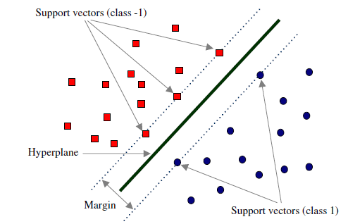
SVM Terminology

Slide 7
Explanation
The goal of the SVM algorithm is to create the best line or decision boundary that can segregate n-dimensional space into classes so that we can easily put the new data point in the correct category in the future. This best decision boundary is called a hyperplane.
SVM chooses the extreme points/vectors that help in creating the hyperplane.
These extreme cases are called as support vectors, and hence algorithm is termed as Support Vector Machine.

Slide 8
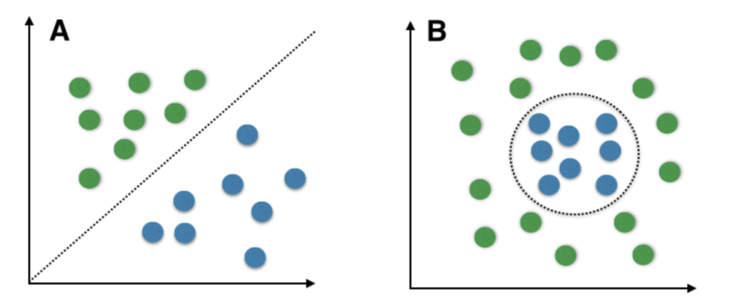
Types of problems
SVM works very well without any modifications for linearly separable data.
Linearly Separable Data is any data that can be plotted in a graph and can be separated into classes using a straight line.
A: Linearly Separable Data B: Non-Linearly Separable Data

Slide 9
SVM for complex (Non-Linearly Separable)
We use Kernelized SVM for non-linearly separable data.
Say, we have some non-linearly separable data in one dimension.
We can transform this data into two-dimensions and the data will become linearly separable in two dimensions.
This is done by mapping each 1-D data point to a corresponding 2-D ordered pair.

Slide 10
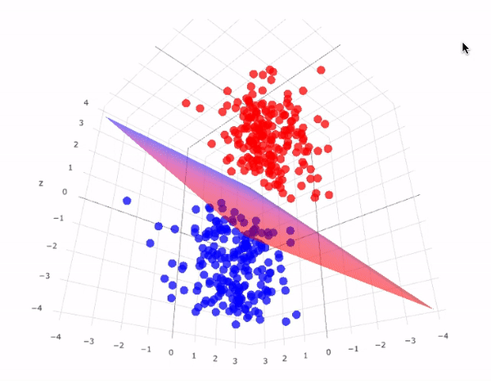
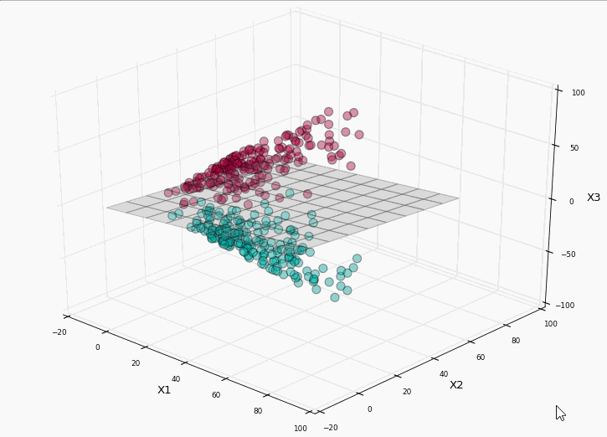
Different examples

Slide 11
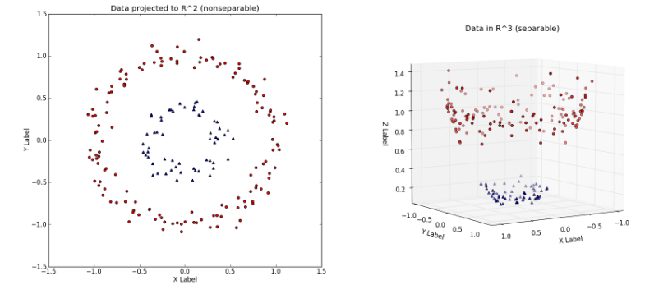

Slide 12
A kernel is nothing a measure of similarity between data points.
The kernel function in a kernelized SVM tell you, that given two data points in the original feature space, what the similarity is between the points in the newly transformed feature space

Slide 13
There are various kernel functions available, but two of are very popular :
Radial Basis Function Kernel (RBF): The similarity between two points in the transformed feature space is an exponentially decaying function of the distance between the vectors and the original input space. RBF is the default kernel used in SVM.
Polynomial Kernel: The Polynomial kernel takes an additional parameter, ‘degree’ that controls the model’s complexity and computational cost of the transformation
A very interesting fact is that SVM does not actually have to perform this actual transformation on the data points to the new high dimensional feature space. This is called the kernel trick. (Read this article→ https://towardsdatascience.com/the-kernel-trick-c98cdbcaeb3f)

Slide 14
Important Parameters in Kernelized SVC ( Support Vector Classifier)
The Kernel : The kernel, is selected based on the type of data and also the type of transformation. By default, the kernel is Radial Basis Function Kernel (RBF).
Gamma : This parameter decides how far the influence of a single training example reaches during transformation, which in turn affects how tightly the decision boundaries end up surrounding points in the input space. If there is a small value of gamma, points farther apart are considered similar. So more points are grouped together and have smoother decision boundaries (may be less accurate). Larger values of gamma cause points to be closer together (may cause overfitting).
The ‘C’ parameter : This parameter controls the amount of regularization applied on the data. Large values of C mean low regularization which in turn causes the training data to fit very well (may cause overfitting). Lower values of C mean higher regularization which causes the model to be more tolerant of errors (may lead to lower accuracy).

Slide 15
Advantages of SVM
Effective in high dimensional spaces
Still effective in cases where the number of dimensions is greater than the number of samples
Uses a subset of training points in the decision function that makes it memory efficient
Different kernel functions can be specified for the decision function that also makes it versatile

Slide 16
Disadvantages of SVM
If the number of features is much larger than the number of samples, avoid over-fitting in choosing kernel functions and regularization term is crucial.
SVMs do not directly provide probability estimates, these are calculated using five-fold cross-validation.

Slide 17
MUST READ
https://towardsdatascience.com/svm-and-kernel-svm-fed02bef1200#tuning
https://towardsdatascience.com/the-kernel-trick-c98cdbcaeb3f
Must do→ GridSearch in Notebook uploaded in Brightspace.

Slide 18
Reading
https://www.javatpoint.com/machine-learning-support-vector-machine-algorithm
https://www.geeksforgeeks.org/introduction-to-support-vector-machines-svm/
https://www.tutorialspoint.com/machine_learning_with_python/machine_learning_with_python_classification_algorithms_support_vector_machine.htm
https://scikit-learn.org/stable/modules/svm.html
https://www.datacamp.com/community/tutorials/svm-classification-scikit-learn-python
https://www.freecodecamp.org/news/svm-machine-learning-tutorial-what-is-the-support-vector-machine-algorithm-explained-with-code-examples/

